Slide 1
Decentralizing and differentiating HIV care for MSM living with HIV in Guatemala City: Acceptability and Retention in Care
Clare Barrington, M. Itzel Loya Montiel, Sanny Northbrook, John Williams, Juan Pablo Alvis, Renato Leonardo Santa Luce, Karla Guzman Guevara, Rodolfo Pinzon Meza, Mario E. Anton Urbina, Mario Ricardo Calderon

Slide 2
Dr. Carlos Rodolfo Mejía Villatoro April 15, 1957- May 23, 2017

Slide 3
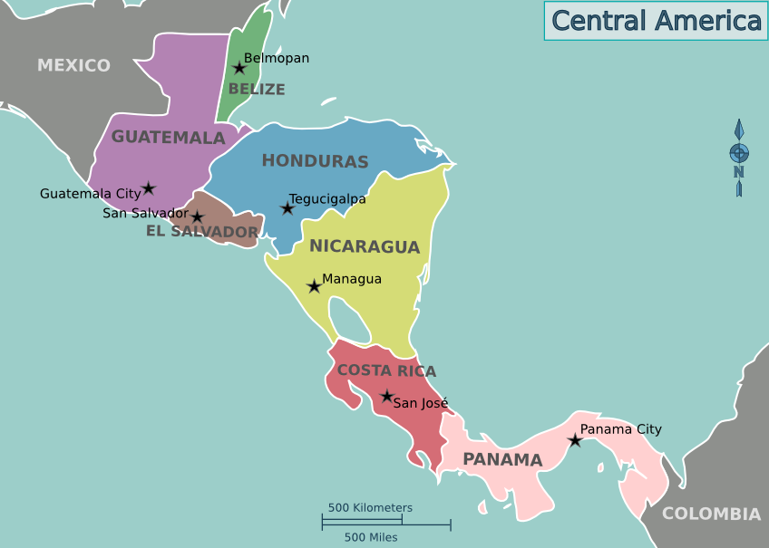
Background: HIV in Guatemala
Population 17+ million
HIV prevalence among MSM is over 17 times greater than the general population¹
10.5% vs. 0.6%
Barriers to retention in HIV care include HIV clinic dynamics and limited employment opportunities, which impact economic stability²
HIV care and treatment are highly centralized in Guatemala

Slide 4
Background
Centralization of HIV care and treatment can impact access, quality, and cost
Two models of decentralization³:
Partial: start in hospital and transfer to primary care level
Complete: initiate care in a primary care level
Both models have been found to improve retention in HIV care³
Differentiated HIV care: adapted to needs and preferences of sub-groups of clients⁴
Notes:
³ Kredo T et al 2013;⁴ Global Fund 2015

Slide 5
Purpose
To determine acceptability, satisfaction and HIV outcomes with decentralized and differentiated HIV care and treatment
for MSM in Guatemala City.

Slide 6
Design and Sample
Key Population Implementation Science (KPIS) project from January 2017 to June 2018
Formative research to inform approach to decentralization
All participants recruited at Roosevelt Hospital Infectious Disease Clinic
Eligibility criteria: “stable patients”
> 18 years old
Male
Self-reported sex with men
Diagnosed with HIV
Enrolled in care for > one year without interruption
Viral load < 1,000 copies/mL
On first-line treatment

Slide 7
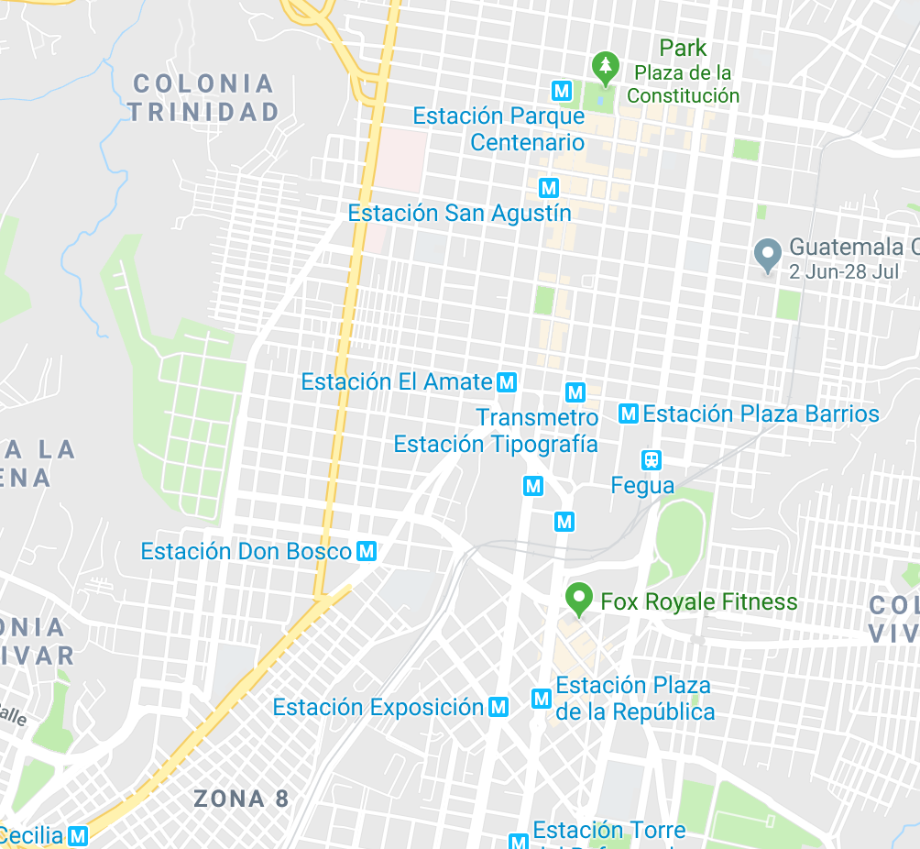
Decentralization
Voluntary, partial decentralization to 3 key population-friendly clinics:
Fundación Marco Antonio (FMA): NGO with history of HIV care in major market/transport hub
Colectivo Amigos contra el SIDA (CAS): Gay men’s health and human rights NGO located close to city center
Zone 3 Health Clinic: Government STI clinic

Slide 8
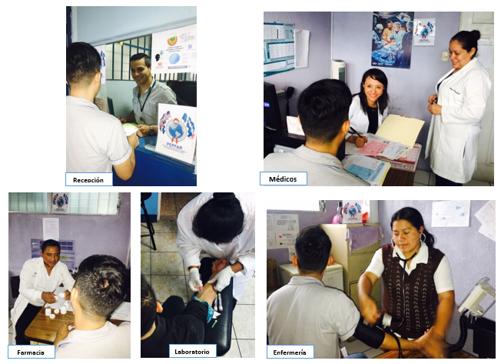
Decentralization
Decentralization clinics offered distinct days and hours of service
Bi-directional capacity building between providers with specialization in HIV and STI
Other intervention components:
Navigation
mHealth appointment reminders

Slide 9
Evaluation
Mixed methods evaluation including:
Socio-behavioral surveys at baseline and 12 m follow-up
In-depth interviews with sub-cohort (n=20) at baseline, 6m, 12m
Clinical chart review (every 3m)
HIV outcomes:
Retention in care: attendance at scheduled HIV clinics every 3 months
Adherence: self-report of missed doses of ART in the last 4 days
Undetectable HIV viral load was defined as <20 copies/mL
Thematic qualitative analysis, descriptive statistics, and bivariate analysis to describe and assess indicators and processes related to acceptability and retention in care

Slide 11
Results: Acceptability
Among 258 eligible participants recruited for the study:
46% accepted decentralization
54% chose to stay at the centralized clinic
Clinic Selections
FMA | 41% (53/128)
CAS | 51% (65/128)
Zone 3 | 8% (10/128)

Slide 12
Results: Acceptability
Reason to decentralize:
Location (home and work)
Personal experience with the clinic
Positive perception of the clinic
Altruism
“…it’s closer, not so close to my house, but rather it’s an ideal location that I can get to easily and quickly...”
Reason to stay:
“Well, I can tell you that transferring to another clinic, I feel that would be really different, a big change in my life and it will take me a while to join in.”

Slide 13
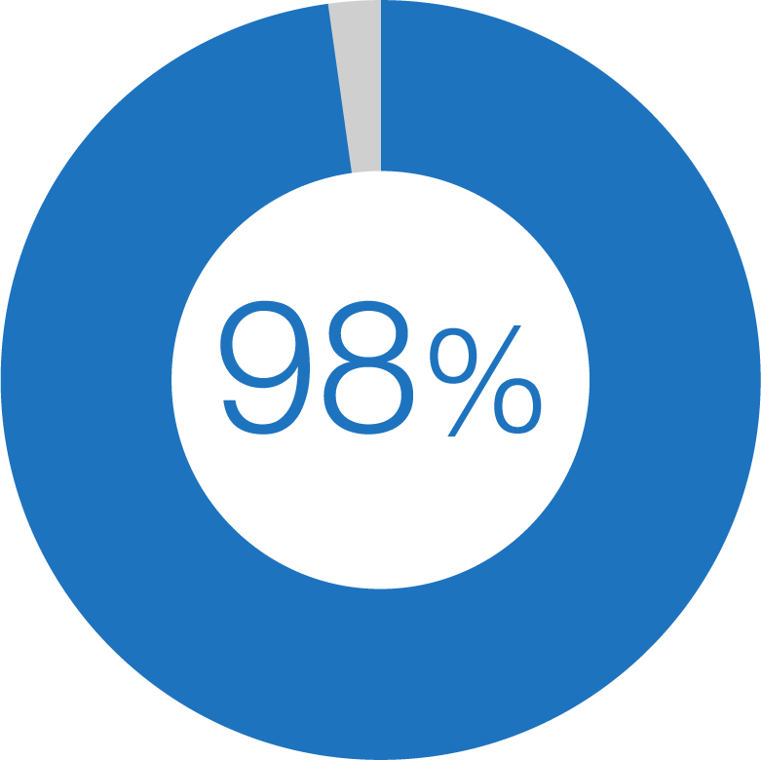
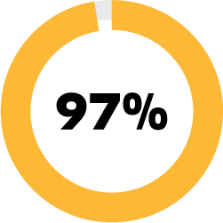
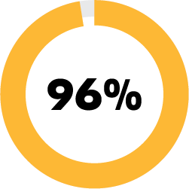
Results: HIV Outcomes
of decentralized participants attended all 3 appointments during the study period
Decentralized participants were just as ART adherent (97%) as centralized participants (96%) at endline.
Decentralized
Centralized
No changes in undetectable viral load from baseline to endline among decentralized (83% to 81%) or centralized participants (85% to 83%).

Slide 14
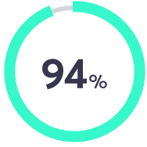
Results: Care Experiences
of participants considered overall quality to be excellent
Median duration of clinic visits: 33min [compared to 4-5 hours at centralized clinic]
Health navigators were highly valued in the unfamiliar decentralized clinics
“He’s [navigator] always ready to help...always asking me how I’m doing, sending me messages...and he’s always here with me at the clinic, making sure they’re treating me well, and that I know what’s going on.”
“We hope that this project continues since due to my work, I can only go on the weekends. Also, we get great, personalized care and don’t have to wait that long.”
“The attention was better. It is close to my job and home and the key is that you don’t waste a lot of time. I would like to continue getting my care here.”
Participants had an integrated appreciation for location, time, and quality of care

Slide 15
Conclusions
Decentralization was acceptable to almost half of the sample
HIV care and treatment outcomes sustained
Decentralized participants were highly satisfied with time, location, and quality of care
Findings support continuing and extending decentralization to create more sustainable, convenient, high-quality HIV care and treatment options

Slide 16
Acknowledgements
Participants
KPIS study team
This study was funded by PEPFAR through the Cooperative Research Agreement between CDC-CAR and UVG EIR-HIV-KPIS CoAg 1U01GH001003-05
Contact: Clare Barrington, PhD, MPH cbarring@email.unc.edu

Slide 17
References
Guardado Escobar ME, Oliva S, Hernandez M, Peren J. Medición de Prevalencia, Comportamiento, Actitudes Y Prácticas En Poblaciones de Mayor Riesgo Al VIH-Sida En Guatemala, 2017.; 2017.
Barrington C, Knudston K*, Paz-Bailey OA, Aguilar JM, Loya-Montiel MI, Morales-Miranda S. HIV Diagnosis, Linkage to Care, and Retention among Men Who Have Sex with Men and Transgender Women in Guatemala City. J Health Care Poor Underserved. 2016;27(4):1745-1760. DOI: 10.1353/hpu.2016.0160. PMID: 27818436.
Kredo T, Ford N, Adeniyi FB, Garner P. Decentralising HIV treatment in lower- and middle-income countries (Review). The Cochrane Library. 2013, Issue 6.
Global Fund. A Toolkit for Health Facilities Differentiated Care For HIV and Tuberculosis. https://www.theglobalfund.org/media/2569/core_differentiatedcare_toolkit_en.pdf

